Slide 1
From local to global
Sharing of Knowledge through participatory Research (Information) Infrastructures
Norbert Lossau
Georg-August-Universität Göttingen
Vienna, 20 May 2014

Slide 2
(Only) a starting point: local repositories

Slide 3
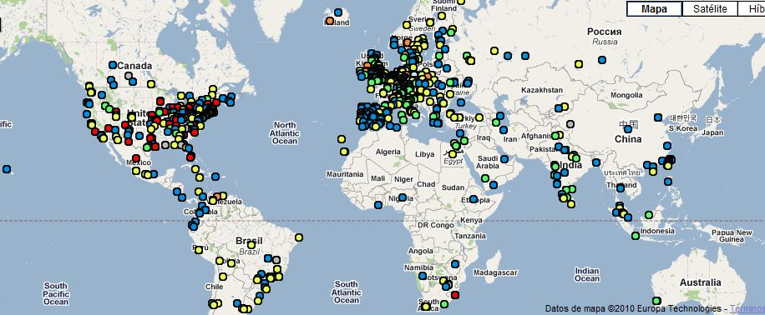
Repositories and Research Infrastructures: more than access
Repositories form the content layer for research infrastructures
A single repository is a “neutral” system which can serve many purposes, e.g. discovery, providing data sets for mining, analysis and visualization, serving publication metrics and statistics, enabling referencing across object type and repositories etc.
Access of a single repository through a human user-interface can be useful but it is generally of limited scope
The full potential of digital content, stored on thousands of repositories around the world can only be exploited once they are connected
This means to provide and expose repository content to machines, tools, service and portal providers, which aggregate, analyze, and mine etc. on the virtually created knowledge resources.
The Case for Interoperability for Open Access Repositories - COAR Briefing Paper

Slide 4
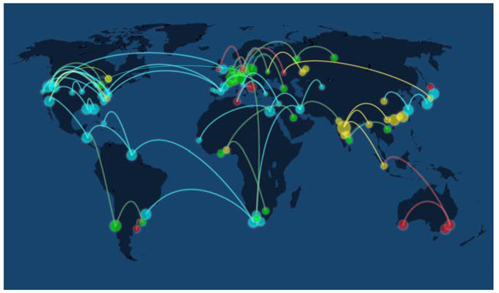
Vision
A global research (information) infrastructure, based on worldwide networked open access digital repositories
Europe/OpenAIRE
Network ...
SHARE
China
Japan
LaRefencia
Network ...
Network ...
Australia
Mission
To facilitate greater visibility and application of research outputs through global networks of open access repositories based on interoperability and international cooperation

Slide 5
Where do we stand?
2030
Global Repository Network(s)
2014
Regional Repository Networks
National Repository Networks
Repositories (IR, DR, ...)
Santa Fe Convention
1999

Slide 6
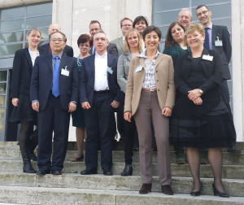
Rome, March 2014: A new strategic initiative has started
Paul Ayris, Director of University College London Library Services and President of LIBER (United Kingdom)
Donatella Castelli, Senior Researcher, CNR-ISTI, Italian National Research Center and Technical Director, OpenAIRE (Italy)
Carmen Gloria Labbé, Deputy General Manager, CLARA and La Referencia and Vice-Chairman, COAR (Chile)
Norbert Lossau, Chairman of the Board, COAR and Vice-President, University of Göttingen (Germany)
Rick Luce, Co-Chair SHARE Steering Group and Associate Vice President for Research and Dean of University Libraries, University of Oklahoma (United States)
Natalia Manola, Department of Informatics & Telecommunications, University of Athens and Project Manager, OpenAIRE (Greece)
Katharina Mueller, Head of COAR Office
Brent Roe, Ex. Director, Canadian Association of Research Libraries (Canada)
Eloy Rodrigues, Director of the Documentation Services, University of Minho and Chair, COAR Repository Interoperability Working Group (Portugal)
Kathleen Shearer, Ex. Director, Confederation of Open Access Repositories (Canada)
Judy Stokker, Deputy Vice-Chancellor, Technology, Information and Learning Support, Queensland University of Technology and Chair, Australian Open Access Support Group (Australia)
Marta Viragos, Deputy Director, University and National Library University of Debrecen and Treasurer, COAR (Hungary)
Tyler Walters, Co-Chair SHARE Steering Group and Dean of University Libraries and Professor, Virginia Tech (United States)
Xiaolin Zhang, Executive Director, National Science Library of Chinese Academy of Sciences (China)
http://www.coar-repositories.org

Slide 7
China

Slide 8
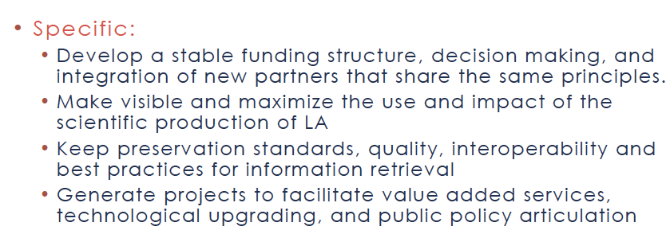
Latin America

Slide 9
SHARE: Toward a Federated Repository System for Data & Publications in the USA
(SHared Access Research Ecosystem)
Ensuring broad and continual access to university research is central to the mission of higher education
Recent US gov’t initiatives to ensure public access to federally funded research outputs have created new/timely opportunity for HE community to better structure its strategies and systems for managing data / publications
Independent of how federal agencies choose to implement the new OSTP directive, HE is uniquely positioned to play leading role in successful stewardship of research
HE community also has an interest in collecting and preserving their researchers’ scholarly output for reasons beyond ensuring access, such as for promotion and tenure and for analytic purposes
Research publications, research data, and associated metadata should be publicly accessible; accelerates research and discovery
Notes:
roles for research libraries in the 21st century, in particular in e-science
Memory stick
Attended by researchers; Talk about 1-2 challenges, connectors to scientists

Slide 10
Europe – OpenAIRE(plus)

Slide 11
How to move forward
Achieve common understanding
Alignment ≠ do it the same way, allow variety, better principles

Slide 12
Vision
Researchers, regardless of location or discipline, have open access to research results (publication + data), the valuable content created through publicly funded research. In support of this, repository networks work together to provide seamless access to research outputs and adopt common practices that maximize the ethical re-use of content and development of value added services.

Slide 13
Benefits of global alignment
“All efforts should be made to avoid silos, which act as barriers to the use of content.”
Benefits:
Enable the exchange of data between repositories and support the creation of new services.
Allow governments and funding agencies to gather more uniform information about the impact of the research they fund.
Learn from each other and facilitate progress
Lead to cost synergies by preventing duplication of work across networks.

Slide 14
Challenges to global alignment
“It would be impossible and undesirable to seek to align networks across all areas and elements.”
Challenges:
Regional diversity in systems and requirements
Heterogeneity of objectives, plans, implementation speed, and mandates
Lack of shared directive
Sustainability and governance issues for many regional, national networks

Slide 15
It was agreed…
Repositories are research infrastructure that are/will play a variety of roles for a variety of communities: open access, research evaluation, data curation, etc.
Strategically it is important and beneficial to align networks
We want COAR to be the umbrella organization for this work
We want our work to reflect a future vision as well as addressing the current issues of importance

Slide 16
Common Principles
Openness: Open access to research outputs resulting from publicly funded research should be timely and user friendly.
Sustainability: Research outputs of long-term value should be accessible for current and future generations.
Interoperability: Technological and semantic interoperability are key considerations for enabling access and re-use of content. Repository networks should adopt common standards across networks in support of interoperability.
Diversity: Diversity in approaches is beneficial. Diversity drives innovation and enables regions to respond to unique objectives and requirements.

Slide 17
Current Priorities
Policies
Limiting embargo periods: Any delay in the free availability of research outputs will curtail scientific progress and innovation. Repository networks will continue to emphasize that immediate access should be considered best practice. If embargos are to be imposed they should be a maximum of 6-12 months (depending on discipline).

Slide 18
Current Priorities
Technological and Semantic Interoperability
Incorporate ORCID IDs into repositories globally
Promote the use of persistent identifiers
Standardize certain vocabulary elements that express important concepts including, but not limited to: embargo periods, access and re-use conditions, funder IDs
Establish and adopt of common approaches to collecting usage data and impact measures
Implement protocols that enable data exchange and cross-system transfer and repository networks and other systems.

Slide 19
Current Priorities
Services
Share emerging practices for managing research data and linking data to publications
Promote the role of repositories within research evaluation systems
Develop a list of existing services deemed critical for the global research repository community (e.g. repository registries, publisher policy registries, etc.) and discuss how they could be better supported

Slide 20
Towards a global research infrastructure...
2030
Global Repository Network(s)
RIs...
Aligning repository networks initiative
Regional Repository Networks
2014
National Repository Networks
Repositories (IR, DR, ...)
Santa Fe Convention
1999

Slide 21
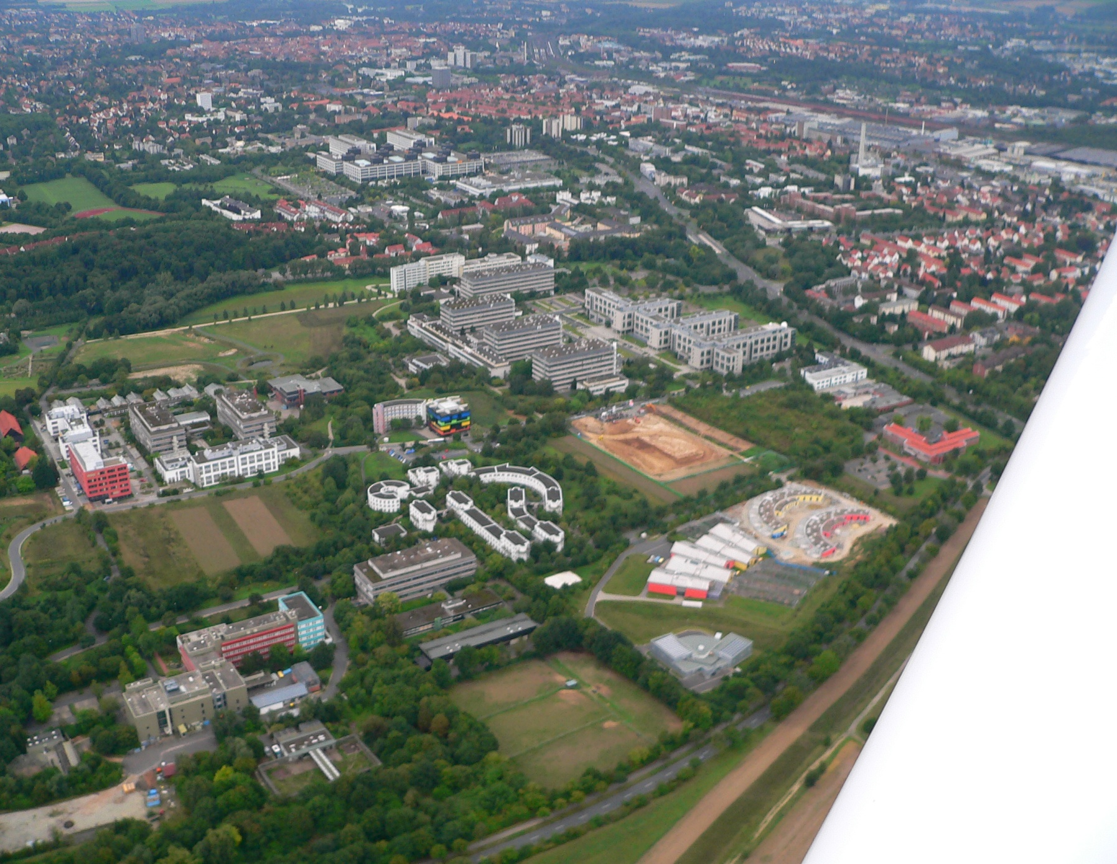
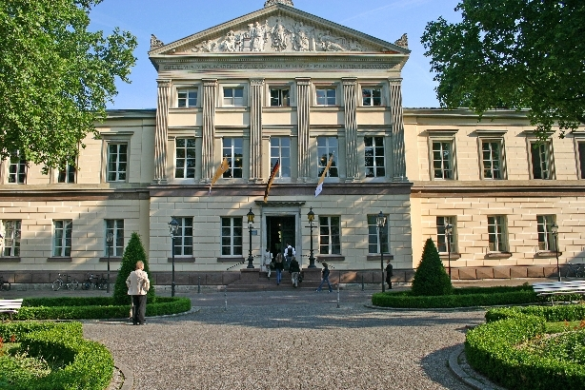
Contact:
norbert.lossau@zvw.uni-goettingen.de
D-MVOX
Göttingen Research Campus
Notes:
Innovation is facilitated through the special situation of the Göttingen Research Campus.
With the 5 Max Planck Instutiutes, the primate centre, Institute of Aerodynamics and Flow Technology and the Academy of Sciences we share many research projects.
We have a formal agreement with the Max Planck Society and individually with the other partners. And the Göttingen research Council is a formal board deciding on the strategy of the campus and advising the university.
Coming to Göttingen this year in January I was really striked by the excellent daily life cooperation with the partners in the campus.
And being responsible for the qualification of 25.000 students I am impressed by the commitment of our partners in teaching, which is done by some colleagues with extreme enthusiasm and high qulaity
Is there any such thing as a ‚Göttingen spirit’ today?
Open-minded cooperation; Barrier free cooperation across disciplines and institutional boarders, No barriers between university and non-university research institutions;
Being honest with ourselves; Doing things instead of talking about them
We do not need a fusion with non-university institutions – we already live close cooperation without making much ado about them.
In Goettingen, “town and gown” are very harmoniously connected; wherever you go in Goettingen you find the University. non-existence of real barriers; a ubiquitous willingness to cooperate includes not only the whole of the University but the MPIs as well.
It is somehow in the Academy of Sciences and Humanities and that institution opens more and more for younger scholars and especially for women. Good spirit of research, inspiration and discussion among scholars and with students is well the practise in some departments. Göttingen is very well equipped for a culture of open research and diversity, fruitful private-professional exchange of scholars in then faculty club.

