Slide 1
Introducing data management planning at an institution
the first wobbly steps of a newborn baby.
Hans Fransen

Slide 2
Original photo credit: Giang Hồ Thị Hoàng
Notes:
Our motto ?

Slide 3
Why ?
There seems to be a need !
Funders Integrity
Visibility Reuse of data
New methods
The library ?
Repository
Metadata specialists
Faculty liaison
Experience with 2011 National project Cards
Searching for new library services
Policy plan
Leiden University Libraries
2011 – 2015
Notes:
University libraries are looking for new services and there seems to be a need
Funder requirements (or announcements of)
Integrity : fraude cases in the Netherlands
Visibility : publication of (underlying) datasets citation
Reuse of data (efficiency, verification)
New methods of research (big data, data mining)
Why the library?
Repository
Metadata specialists
Faculty liaison for outreach and awareness
Experience with 2011 National project Cards (Controlled Access
to Research Data Securely Stored) learned us that
Researchers want support
Researchers want (technical) infrastructure
Researchers want to share their data (in their terms)
Policy plan Leiden University Libraries 2011 – 2015 :
Advise researchers on data management
Train Data librarians
Stage before final archiving

Slide 4
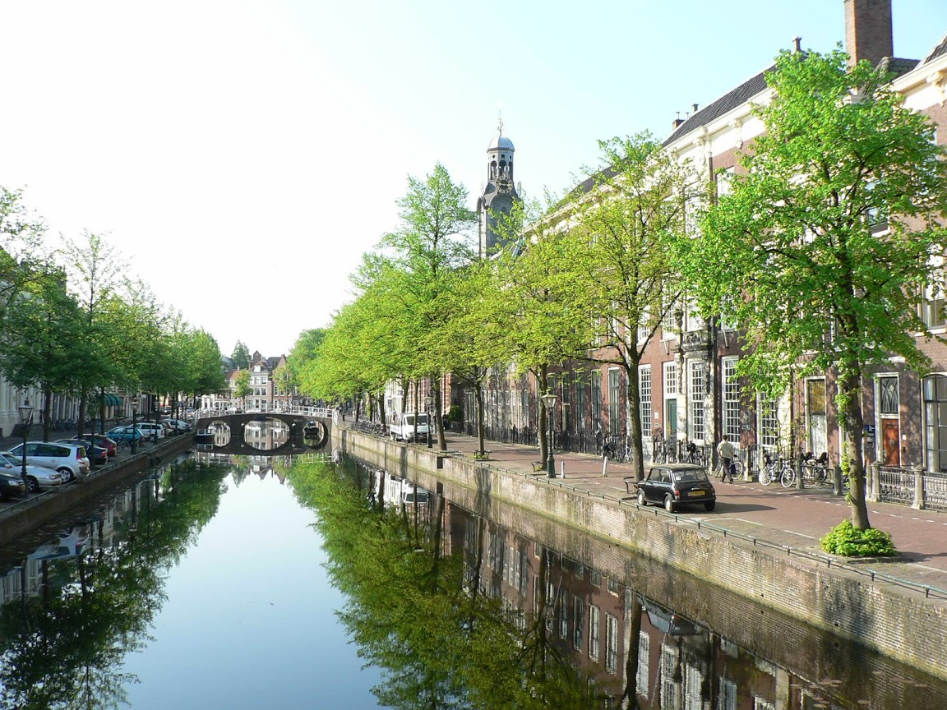
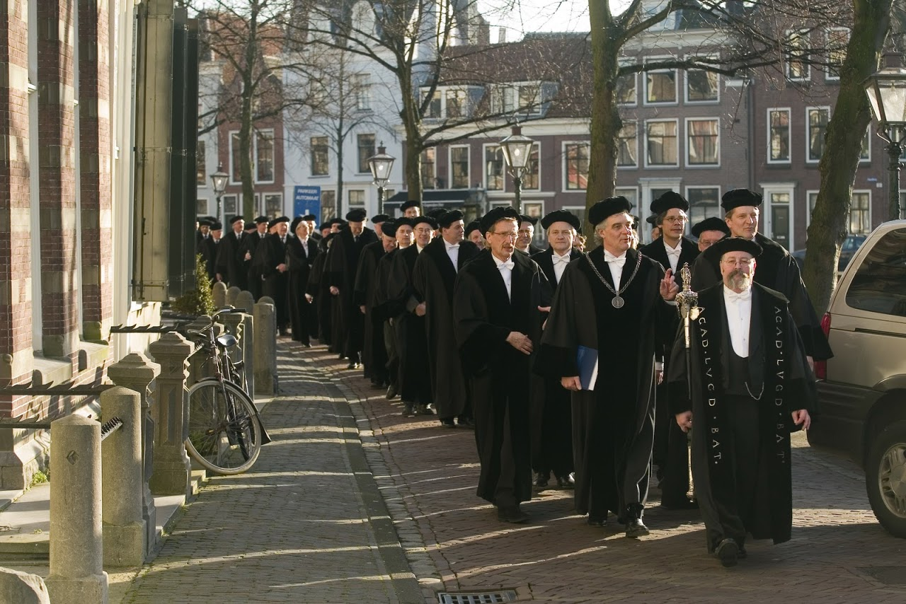
Leiden University
1st Dutch University
Founded in 1575
23,034 students enrolled
1200 academic staff
700 PhD candidates
7 faculties: Archaeology, Campus The Hague, Humanities, LUMC/Medicine, Law, Social and Behavioural Sciences, Science
Notes:
Eerste universiteit in Nederland
Opgericht op 8 februari 1575
Total number of students enrolled 23,034
1200 academic staff, 700 PhD candidates

Slide 5
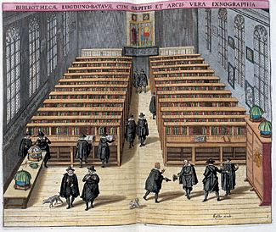
Library
Founded in 1575, when Prince William of Orange donated a copy of the Polyglot Bible
6 locations
110 employees
Notes:
110 employees

Slide 6
Library starts projects
Datalabs
2011
UBL Frontoffice
Data Management
2012
Use VRE to securely manage and share data
Transfer data ‘automatically’ from VRE to data archive
In collaboration with ‘backoffice’ =
National data archives DANS and 3TU.Datacentrum
Notes:
Data (wanneer speelde dit?)
Verwijzen naar Faculty of Archeology
Sharepoint

Slide 7
Planning, preparation
Frontoffice Leiden Research Data Office
Data Management Plan
Data production, analysis
and sharing
Datalabs
VRE
Backoffice
Data Archives
Archiving and publication
DANS
3TU
Notes:
20 VRE’s

Slide 8
Notes:
8th International Digital Curation Conference jan 2013, other Dutch universities were interested
Benefits researchers: FO curation knowledge, betteraccess to storage, gain time
FO: Knowledge + storage BO and partner in research
BO: via FO better contact and more datasets

Slide 9
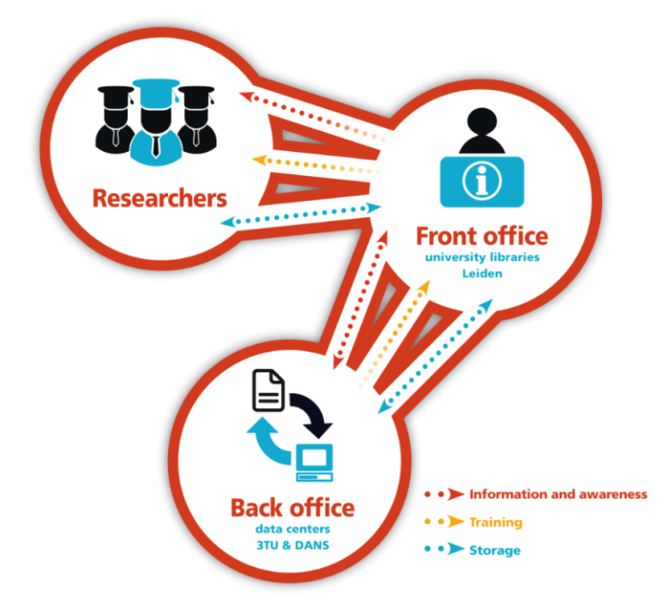
Backoffice - Roles
Expertise centers on data management and
sustainable archiving
Train library staff and help in
workshops for researchers
(“Data Intelligence 4 Librarians”)
Archive our data sets :
University does not have a repository
for data
Notes:
Other university libraries were interested
Iets over samenwerking DANS & 3TU

Slide 10
Front Office - Roles library staff
Director : RDM policy
Data librarians (2 people, 2x 16 hours weekly)
For researchers : motivating, answering questions, assistance, workshops, training
For support staff : knowledge sharing (internal and external)
Cooperation with back office
Subject librarians
Faculty liaison : create awareness by discussing the topic
Concrete support : simple questions, VRE’s, curate datasets
Integrate module in courses for research master students
Participate in workshops
Information specialists : information desk (refer and administrate questions) ; find datasets
Other : Digital Services (datalabs) ; Metadataspecialists, Copyright Information Office
Notes:
So how did we embed these new tasks in the organisation?
Commentaar: weinig mensen
Goed werk Kurt, when things really got hot the library was there.

Slide 11
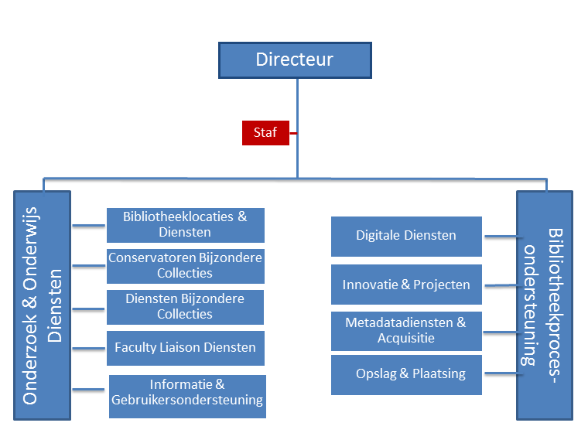
Policy issues
Data librarians
Datalabs
Lending desk
Subject librarians
Copyright Information Office
Information specialists
Metadata specialists

Slide 12
March 2013 End of Project
FO – BO
Business model yet to test
Not much interest research groups
No datasets sent to Back Offices
Small number of workshops
Some requests via LURIS, Leiden Research Support Services contact point for questions on funding
How to connect to research community ?
Faculty liaison, but…
Few people, little time
Notes:
Then came the hard part
Wel veel effort in internal communication

Slide 13
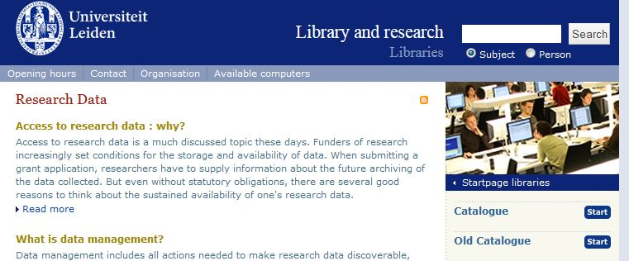
However
Knowledge & Experience
Communicated within organisation
Communication at National level
UKB working groups:

Slide 14
But then…..
Funding agencies were getting nasty
NWO, EU (Horizon 2020), others (journals)
Riding the Waves (UK, Denmark, NL, Germany)
“Data sharing will be part of the academic culture”
Researchers were misbehaving
Integrity issue
Notes:
Stapel beelden
Horizon2020

Slide 15
Faculty of Social Sciences were the first to act
in 2013
Supported by Academic Affairs, Faculty Staff, ISSC & information managers, Library, Research Support Group
Best practices?
Define roles and responsibilities
Inventory of support, infrastructure and training needs
University Policy for research data management
The Executive Board invited representatives for presentation on the subject (ICT, library, Social Sciences)
Notes:
Kurts dia’s hier?

Slide 16
RDM awareness in University
2013
Demand for infrastructure and policy by Medical and Social Science faculties
Workshop and start of pilot project in Social Sciences
2014
Pilot projects in all faculties : explore data management needs trough workshops and data management plans
Academic Affairs : develop policy by recording roles and responsibilities
Research Support Office : templates for researchers applying for funding (Horizon 2020 ; NWO)

Slide 17
Faculties
Make an inventory of research workflows and current practice with regard to data management within the various disciplines within the faculty and to the needs in this area by the researchers (knowledge, advice, support, facilities).
Active participation of researchers in the exploration and subsequent projects is crucial
One or more prominent scientists should pull these projects and take the lead in the implementation.
Project Science Faculty: define format DMP and need for assistance
Digitizing, finding back, metadata (same tools all institutions)
Policy, rules & regulations university
Law and legislation (integrity)
Requirements funders
Sharing & reuse less important
Notes:
FWN:
dat het de instituten gaat om te digitaliseren, data terug te kunnen vinden en daar de juiste metadata aan te koppelen. Vervolgens moet die data ergens opgeslagen worden. De behoefte aan het delen van data en het gebruiken van data van anderen is klein. Het gaat vooral om wetenschappelijke integriteit, aangezwengeld door incidenten en de maatschappelijke discussie daarover.
Het doel voor FWN is tweeledig, namelijk (i) om een verantwoorde en excellente wetenschapsbeoefening te
stimuleren en (ii) om het datamanagement te laten voldoen aan wet- en regelgeving, eisen van financiers en
universitair beleid. Het uitgangspunt is ‘gemeenschappelijk, tenzij’, wat inhoudt dat waar mogelijk gestreefd
wordt naar dezelfde tools en software voor heel FWN.

Slide 18
The library
From being a misionary to concentrating on delivering a good service.
Involved from the beginning
workshop Social Sciences, policy plan, pilots faculties
Looking for role related to other organisations
research support, information managers, ICT shared service centre
First impression: support DMP’s
Notes:
Verhaal Kurt (dia’s)

Slide 19
Leiden Research Data Office 2014
Notes:
Participate in university DM projects : workshops, data management plans
Inform and advise individual researchers ; help curate datasets for archiving ; help comply funding requirements
Assist VRE’s in good data management from the start (naming conventions, formats, versioning, metadata, certified archive); quality control of data before ‘automatic’ archiving
National cooperation, aimed at sharing knowledge
masterclass organized by Dutch University Libraries
Participate in training for support staff
Leiden, Delft, Rotterdam cooperation

Slide 20
Recommendations
Involve all stakeholders : ICT, Academic Affairs, Chairmen of the faculties, Research Support Office, Researchers...
Start training enough support staff early on, intensify faculty liaison, be prepared…
Offer infrastructure(s) for storage that allow different levels of authorization, security etc.
Think twice before creating a repository for datasets (certification issues)
Search national and international cooperation

