Slide 1
Paolo Budroni
e-Infrastructures Austria
An initiative to foster the coordinated development of Austria-wide infrastructures for digital resources in research and academic teaching

Slide 2
e- Infrastructures Austria at a glance
e-Infrastructures Austria is an initiative designed to foster the coordinated and on-going development of Austria-wide infrastructures for digital resources in research and academic teaching.

Slide 3
e- Infrastructures Austria at a glance
[Abstract: A key objective of the initiative is to include research communities, libraries and IT services of all national universities and other scientific institutions, and to jointly develop knowledge for the construction of local repositories in order to pool existing expertise and resources. The intended goal is then to make this knowledge available to all of the project institutions involved. Within the three-year project period, all partner institutions are to set up a local document server or be granted access to a shared document server. A parallel objective is the design and eventual establishment of either a central or several decentralized Austrian repositories for advanced applications and digital objects, including research data, documents, and multi-media content.]

Slide 4
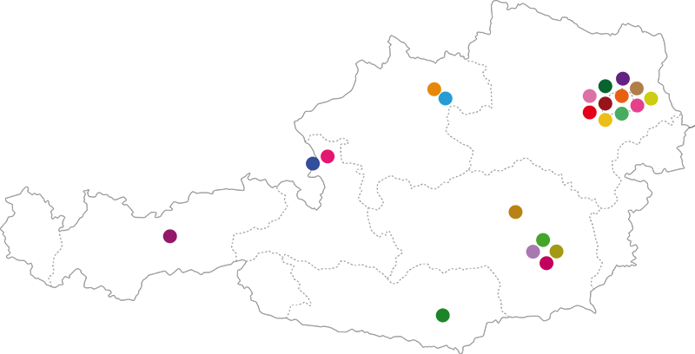
Fact Sheet
Start: 1 January 2014
End: 31 December 2016
Project coordinator: University of Vienna
Project partners: 25 Partner Institutions
Client: Federal Ministry of Science, Research and Economics

Slide 5
Data and process management plans
world of data
Steps, into the repositories
processed data
Repositories
processed data
visualization
shared data
released data / published Data
OA-published data

Slide 6
Background /1
The management, storage and provision of digital resources are important tasks of scientific institutions. In addition to publications and digitized theses and dissertations, more complex digital objects (research data, multimedia, e-learning content, and so on) and their subsequent use have increasingly gained importance in the last few years. With the advancement of technologies, completely new approaches and methods have availed new access to data regarding its representation and reuse in research. The concept of accessibility today extends far beyond merely downloading objects, and provides various forms of reuse.
Ensuring legal compliance is key in this context.

Slide 7
Background /2
In some areas of research, dealing with disciplinary (research data-based) repositories or data centers is a regular part of the scientific life. Institutional repositories, which are often multidisciplinary, complete the picture of an inclusive and sustainable infrastructure. The research achievements at an institution are then made visible, permanently available and are offered both for reuse for researchers as well for the interested public. These repositories then contribute to Open Access approaches based on each policy currently used, and they highlight the interoperability with existing systems in the institution as well as systems outside the institution. In this way, the necessary preparations for the EU funding program for research and innovation – Horizon 2020 – will be met.

Slide 8
Focus research data and research support /1
The phenomenon of research data is not a new one, but its potential in science and the conditions surrounding long-term preservation and reuse are currently being discussed in a broad sense. The accessibility to research data – that is, both “born digital” data as well as digitized – in combination with the use of powerful techniques, support the concept of ​​science being collaborative and open. Experiments create reproducible and traceable results, increasing the visibility for scientists due to the now expanded ability to so readily and easily cite data. An innovative use of data will inevitably lead to new insights and outcomes of improved quality, and will eventually directly affect the reputation of researchers and institutions.
Therefore - > focus on research data and research support

Slide 9
Focus research data and research support /2
The definition of “research data” is characterized by the respective discipline. Data may be of heterogeneous origins, have different formats and different degrees of accessibility. Whether it is published as raw data, processed data, published data or Open Access data: for re-use, it must be identifiable, readable, citable, technically interchangeable, have understandable content, be legally secure and institutionally available. Long-term archiving of data is an ongoing process and many factors for its exchange and re-use are already determined in the course of data generation.

Slide 10
How does e-Infrastructures Austria work? /1
Applied logic
e-Infrastructures Austria coordinates the establishment and development of infrastructures in Austria by:
- Design of a knowledge network
- Establishment of local document servers and
access to shared document repositories for all partner institutions
- Design and development of a central repository (or,
according to certain requirements, several repositories) for advanced
applications and digital objects

Slide 11
How does e-Infrastructures Austria work? /2
Applied logic
A reference model of inter-networked repositories is planned. These digital archives provide citability of contents and offer a variety of standardized interfaces for flexible re-use of managed resources and objects.
When shared by every institution, repositories retain control over their own data.

Slide 12
How does e-Infrastructures Austria work? /3
Applied logic
e-Infrastructures Austria is a response to the opportunities and challenges that arise through the responsible use of digital objects and new technologies. In the project, all technical and non-technical aspects are considered, and there is a dialogue with a diverse group of stakeholders instead, which may be located both inside and outside the institutions. The trans-disciplinary collaboration in the specific work fields is organized into work package clusters.

Slide 13
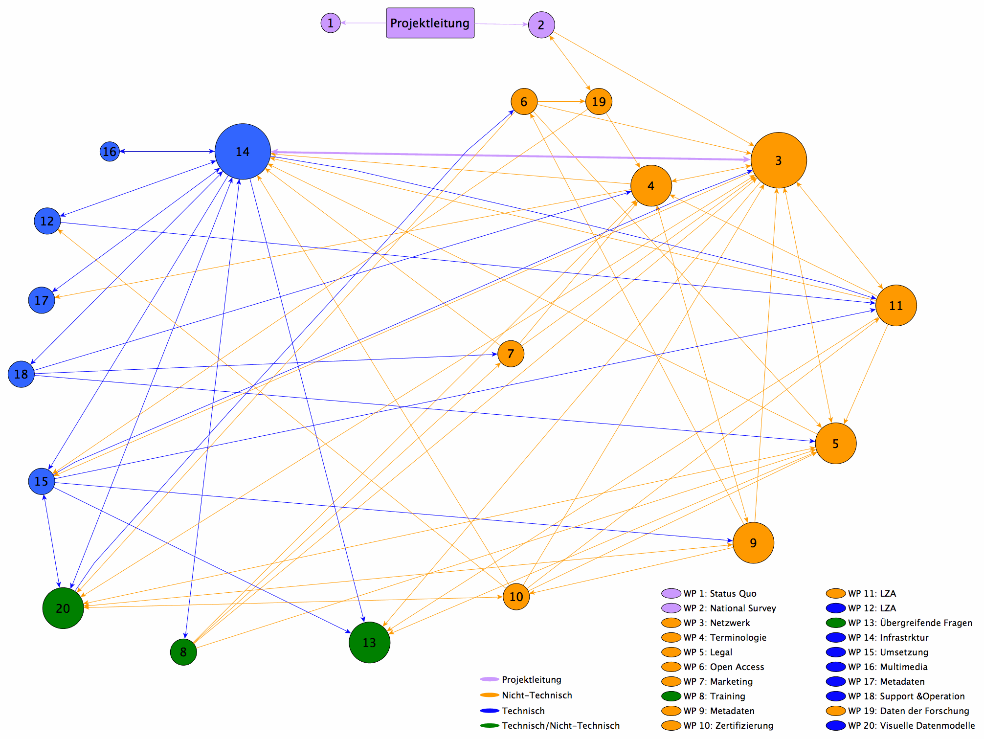
The “subway map” of e-Infrastructures Austria

Slide 14
12 work fields
Cluster A Monitoring and exchange for the construction of repositories in the local bodies
Cluster B Planning and implementation of a “National Survey” for research data
Cluster C Designing a knowledge network: Development of a reference structure for the construction of repositories
Cluster D Designing infrastructure
Cluster E Legal and Ethical Issues
Cluster F Open Access
Cluster G Visual Data Modeling – Generation of science areas
Cluster H Life Cycle Management
Cluster I Metadata complex (from non-technical and technical points of view)
Cluster J Permanent backup of the data (from non-technical and technical points of view)
Cluster K Data from scientific and artistic-scientific research processes (development and appreciation of the arts)
Cluster L Cross-project issues from non-technical and technical points of view
.

Slide 15
Partner network
Development of a reference model for the construction of local repositories with consideration of all technical and non-technical aspects
Jointly develop knowledge, pool existing expertise and resources, and make available to all institutions
Advice and support in developing local repositories (organizational, technical, legal, content-related)
Transdisciplinary collaboration in the context of Work Package clusters with as many stakeholders as possible (libraries, research communities, publishers, IT services, and so on)
Collaboration at technical and non-technical levels
Partner events and workshops
Monitoring of processes in e-Infrastructures Austria

Slide 16
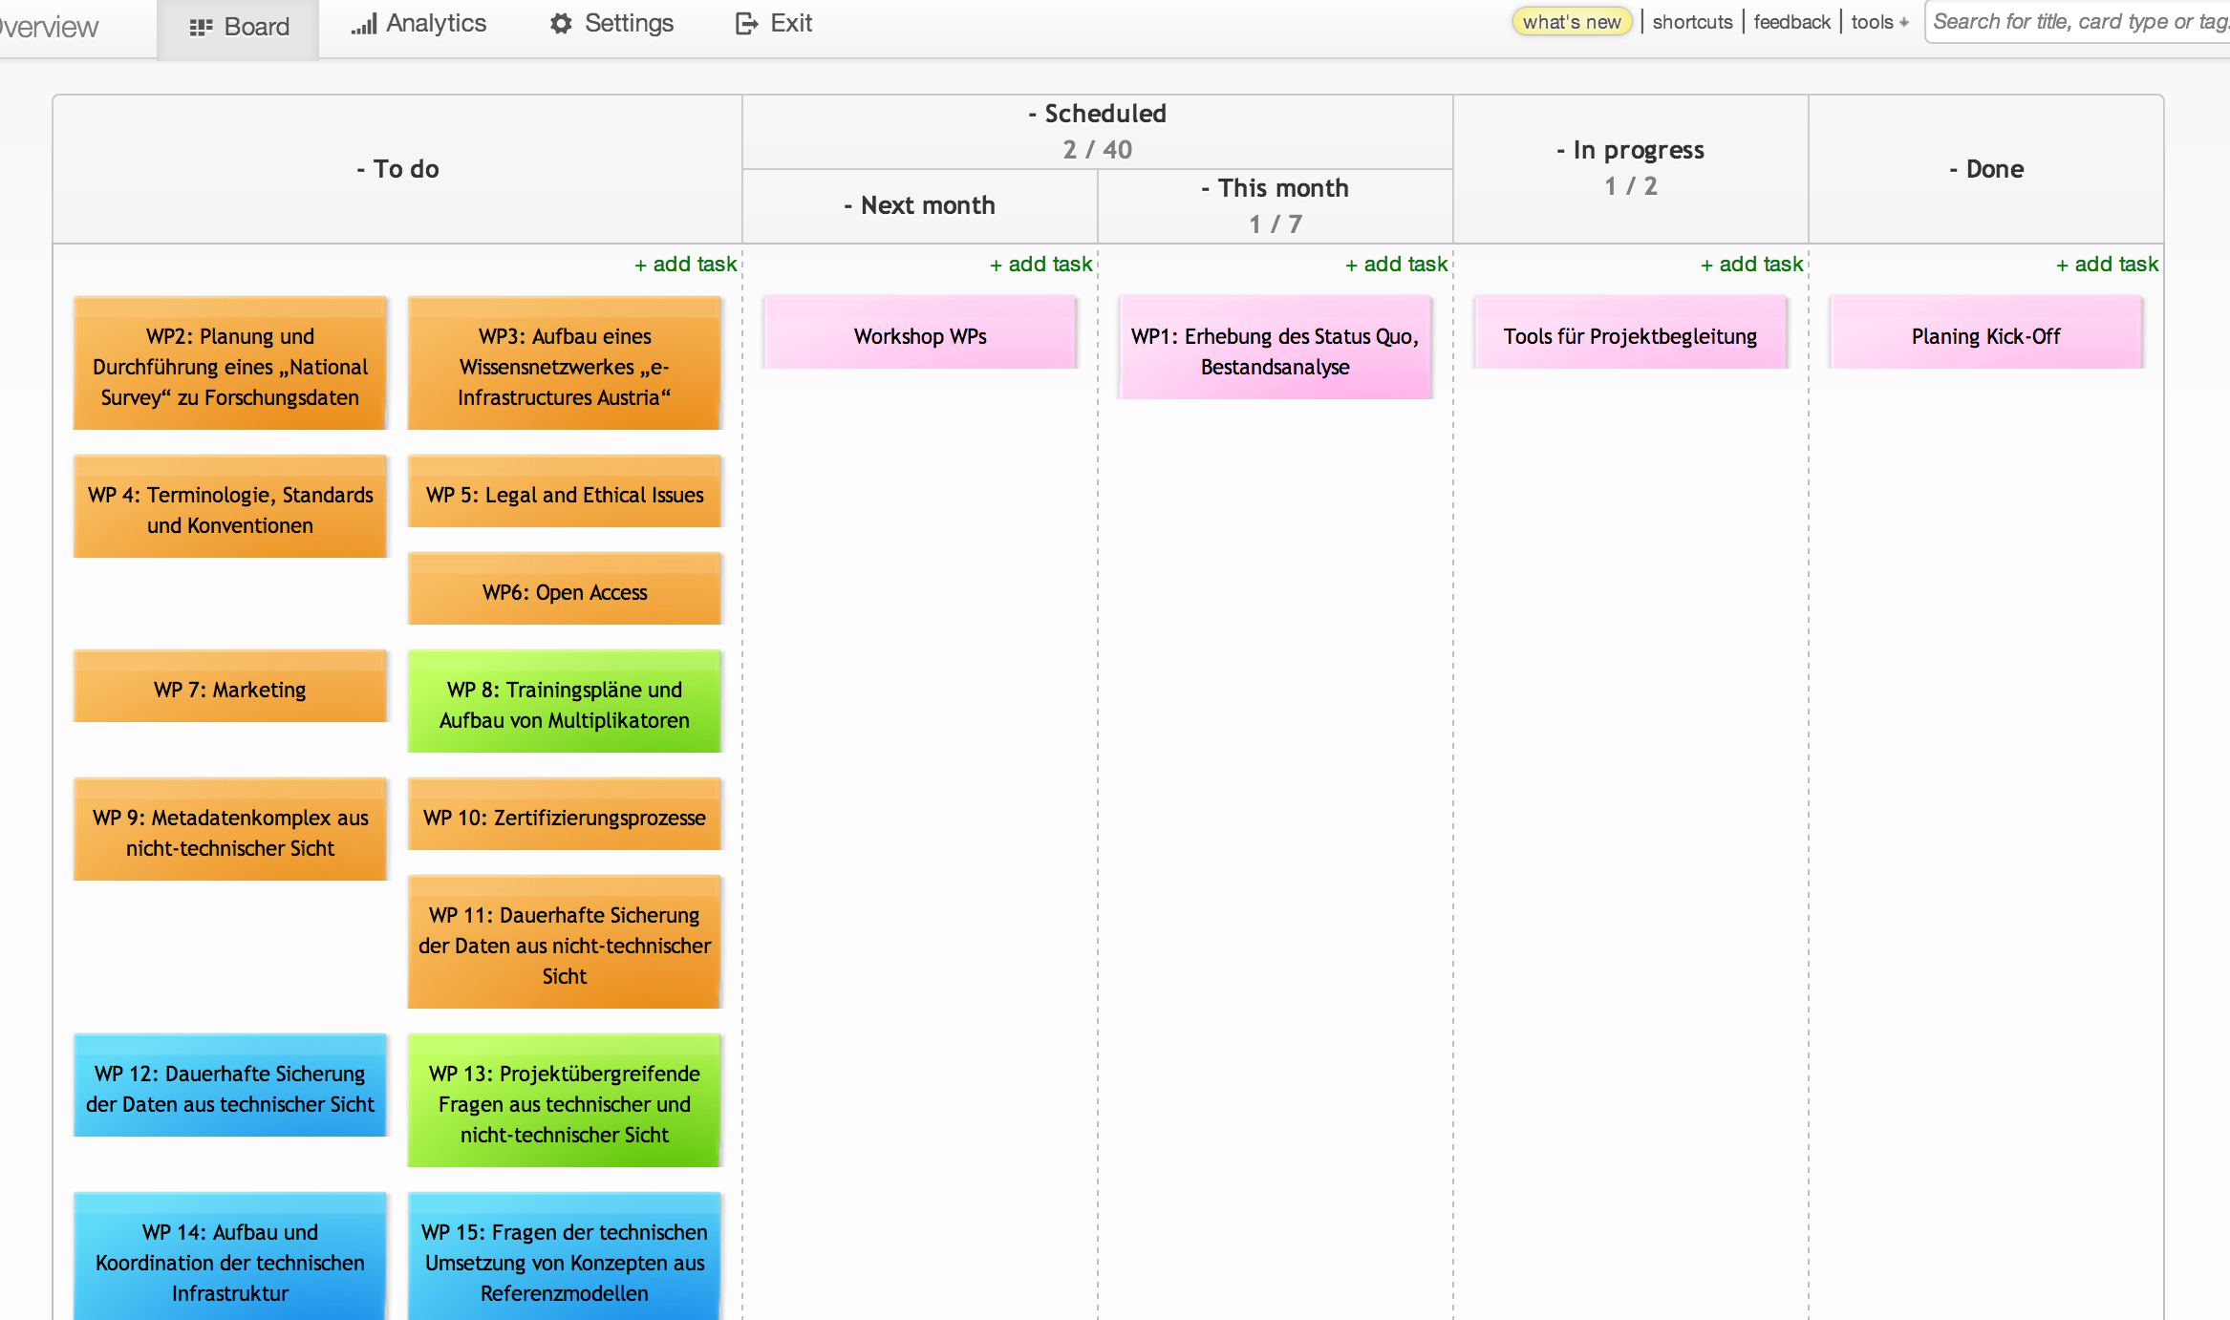
Project management tool

Slide 17
The 3 sub-projects
In its beginning, the initiative includes 25 partner institutions and is coordinated by the University
of Vienna. It is structured in three parallel-running subprojects.

Slide 18
Sub-project A
Development of know-how and technology transfer to enable repositories (institutional repositories in the narrower sense) at universities as well as to advise and support in the development of local repositories in organizational, technical, legal
and content-based issues.

Slide 19
Sub-project B
Development of an Austrian repository for other content types. The objective is to set into motion the necessary processes that enable the management, archiving, retrievability and re-use of research data.

Slide 20
Sub-project C
A third focus is the development of a compe-tence network for research data and data from research-based courses of study of heterogeneous origins with varying levels of accessibility. In addition to the fostering of domestic and international dialogue, other objectives include the grouping of expertise, the sharing of responsibilities, cooperation efforts in the establishment and maintenance of standards and technical requirements (metadata, workflows, and preservation planning) as well as the promotion of the concept of involving scientists in becoming producers of such research content

Slide 21
The 3 sub-projects
time
Project A
Project B
Project C
Construction of (institutional) repositories and publication services
Support of the project partners
Types: „Papers“, Pictures (Formats: mainly PDF, JPG)
Designing an Austrian repository or multiple repositories for further digital objects (research data, e-learning content and multimedia content
Development of services in addition to project A
Phase 1: Models and workflows for reseacrh data
Phase 2: Start of construction of the repository
Phase 3: Multimedia and streaming services
Structure of the knowledge network e-Infrastructures Austria
1
Transdisciplinary collaboration in the context of Work Package clusters involving as many stakeholders as possible (scientists, editors and so on)
2
Examples: Definition of policies,
metadata, interoperability
…
3
Docking to publication services
4
Preparation for
Horizon 2020
Common goals: Increased visibility, standardized repository landscape, harmonization of policies, and, where appropriate, joint visualization and representation surface
Paolo Budroni - e-Infrastructures Austria – 3rd Liber Workshop on Digital Curation – Vienna 19-20 May 2014

Slide 22
Who is e-Infrastructures Austria for?
All Austrian universities
Austrian non-university research institutions
Austrian Research Communities
Research-funding bodies
The interested public

Slide 23
Project partners
e-Infrastructures Austria is a collaborative initiative with 25 partners:
Academy of Fine Arts
Vienna Chamber of Labour
IST (Institute of Science and Technology) Austria
Medical University of Graz
Medical University of Vienna
University of Leoben
Austrian Academy of Sciences
Austrian Library Network and Service, Ltd.
Austrian National Library
Graz University of Technology
Vienna University of Technology
University of Applied Arts Vienna
University of Agricultural Sciences Vienna
Observer Status: FWF - The Austrian Science Fund
University of Art and Industrial Design Linz
University of Music and Performing Arts Graz
University of Music and Performing Arts Vienna
University of Graz
University of Innsbruck
University of Klagenfurt
University of Linz
University Mozarteum Salzburg
University of Salzburg
University of Vienna
University of Veterinary Medicine Vienna,
Vienna University of Economics

Slide 24
Governance
e-Infrastructures Austria: Governance
[Nota Bene: Status May 15th. This model may be subject to modifications in some details. The definitive structure will be decided during the General Assembly of Partners on June 26th]

Slide 25
Proposed Governance
General Assembly
Steering Committee
Project-management
Synergies Team
12 Cluster (WPs)
Think Tank

Slide 26
Project benefit /1
Securing of digital objects (depending on discipline-specific requirements), taking into account quality and guaranteed value
Permanent availability of digital objects
Representation and utilization of research outputs at the institutions in their various aspects by using portal technologies
Increasing the visibility of research performance and networking
Increase the reputation of all project partners and prestige of research at the respective institutions

Slide 27
Project benefit /1
Ensure legal security in the digital age (copyright, right of use, access rights, Internet publishing, re-use of digital content in the university sector for other purposes (such as teaching), Open Access)
Interoperability with existing systems in each institution and interoperability with existing systems domestically (e.g. Federal Promotion Funds and Austrian Research Promotion Agency) and internationally (e.g. Europeana, OpenAIREplus and publishers)
Facilitation of participation in international projects that require the presence of a repository and
Preparation for “Horizon 2020”

Slide 28
Goals /1
Knowledge building in the areas of repositories and research data – documentation and results for all partner institutions.
Design and consecutive development of one central or several decentralized Austrian repositories for complex digital objects, including research data and media content – while maintaining the principle that each institution retains sovereignty over its “own” data
Establishment of a document server for non-institutional publications (“Orphan Records Repository”) and for institutions that do not wish to create their own repositories

Slide 29
Goals /2
Joint development of data management plans for research data
Ongoing expansion of the systems and applications based on new technologies or requirements
Standardization of repositories
Harmonization of repository policies
Contribution to regional development related to EU regional policy

Slide 30
5 Guiding principles
Openness
Free access to the results of the joint work in the project
Regulated ownership of rights within and outside the
consortium (starting with the project and beyond)
Regulated relationship of all partners, defined
organizational units and work processes
Project-oriented entity Think Tank for external stimulus [“thinking out of
the box”], connection between research, IT-services and libraries
30

Slide 31
Contacts: office @ infrastructures.at
Project Coordination: University of Vienna
Library and Archive Services
Head
Maria Seissl
Coordination Office:
Barbara Sánchez Solís
Library and Archive Services
Barbara.Sanchez.Solis @ univie.ac.at
Project Management:
Paolo Budroni
Library and Archive Services
Paolo.Budroni @ univie.ac.at
Technical Project Management:
Raman Ganguly
Computer Center
Raman.Ganguly @ univie.ac.at
31

Slide 32
Further contacts
Website: http: //www.e-infrastructures.at
Wiki: http: //redmine.e-infrastructures.at
Support E-Mail: support @ e-infrastracutures.at
Board: http: //e-infrastructures.kanbantool.com
32

Slide 33
Thanks
paolo.budroni @ univie.ac.at
33

Slide 34
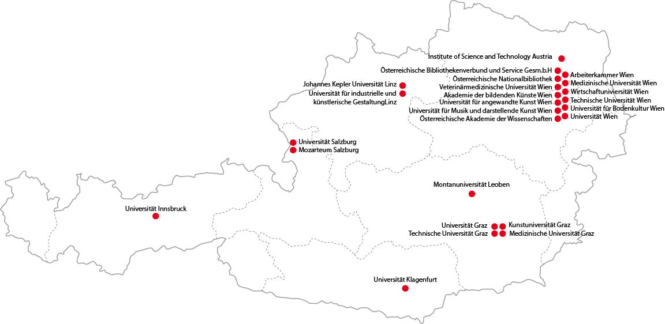
Fact Sheet
Start: 1 January 2014
End: 31 December 2016
Project coordinator: University of Vienna
Project partners: 25 Partner Institutions
Client: Federal Ministry of Science, Research and Economics

