Slide 1
Collaborative Research Data Life Cycle Management –
Strategies and Experiences in European
Humanities Research Infrastructures
Gerhard Budin
University of Vienna, Centre for Translation Studies
UNESCO Chair on Multilingual, Transcultural Communication
in the Digital Age
Austrian Center for Digital Humanities (Network)
LIBER Conference, Vienna, 20th of May, 2014

Slide 2
Focus of this presentation
A convergent view on
Collaborative Scholarly Research
Research Data
Data Life Cycle Management
Digital Humanities
European Humanities Research Infrastructures
In this context: -> Computational Translation Studies (at the University of Vienna) as a case study

Slide 3
On the concept of
Computational Translation Studies (CTS)
Following the generic paradigm of computational sciences
TS carried out with computational methods (incl. literary translation), but also:
TS „dealing with“ computational processes, e.g. machine translation
-> CTS comprises
  At the theoretical-methodological level: Computational modeling of translation processes
  At the pragmatic-processual level: designing and implementing algorithms/systems carrying out translation processes and evaluating them in their performance and ancillary processes needed to support such processes, e.g. term extraction/ recognition, grammatical analysis and many other NLP processes
  Traditionally includes MT/CAT R&D, Computational Terminology (Terminology Studies with computational methods), etc.

Slide 4
One crucial level of Digital Humanities:
Research Infrastructures (RI)
Starting with natural sciences, research infrastructures have been built up since centuries, but in particular since the 2nd half of the 20th century (e.g. astronomy, high-energy physics, etc.)
Today the concept of RI is used in a systematic way for all technical (hardware/machines) and computational (software) devices, buildings, and personnel to operate research processes in any discipline
In Europe, for instance, a long-term strategy has been developed: ESFRI – the European Strategy Forum for Research Infrastructures

Slide 5
On the concept of
Digital Humanities (DH)
Since the 1970s computational methods have been systematically used in humanities disciplines
But much earier, in the 1940s, machine translation and computational linguistics emerged as the first examples of DH
Epistemologically speaking, DH is not only an extensional concept comprising a wide range of disciplines (e.g. digital archaeology, computational linguistics/corpus linguistics) but is also an opportunity to reflect on the theories and methods of the humanities and their conception of objects of investigation

Slide 6
Historical contexts
In some parts of humanities we see long traditions of international efforts to build up RIs (such networked databases, text corpora, collaborative research efforts, data modeling standards, annotation methods, etc.)
  (since the 1970s: „Computers in the Humanities“, Oxford Text Archive, Text Encoding Initiative, Digital Humanities)
  Edition philology + Computer philology, literary computing, etc.
  Computer linguistics, Machine Translation (the earliest)
  Terminology research, LSP (languages for special purposes)
  Archaeology
  International standards (data interchange, Meta data, linguistic annotation, language resource management, terminology, etc.)
  Many EU-Projects as building blocks of RIs increasingly with a concept of sustainability and long-term preservation of data, software, etc. -> very collaborative from the start!

Slide 7
CTS: Towards a Convergence of Different Traditions
Digital Humanities
Multi-lingualism
Language Industry

Slide 8
Towards a Convergence of Different Traditions:
“digital humanities”, referring to a set of practices using computational tools and methods in humanities’ research processes;
“language industry”, essentially covering the global(ized) business of translation (and related) services including the use of a broad spectrum of translation technologies and related tools; and
“multilingualism”, having evolved as a very broad concept including the use of multiple languages in society ranging from the private, individual use of language(s), local (urban, cultural) level up to the global level, but also including the neural dimension (how does the multilingual mind work?), political aspects (promoting language rights, language policies), didactical aspects of language learning, etc.

Slide 9
At the Core of this Convergence
Translation Studies
Computational turn
Computational Translation Studies
Traditional translation
Computational + social turn
Multilingual communications and language resource management

Slide 10
At the Core of this Convergence:
Translation studies and terminology studies serve here as examples of humanities disciplines (although both are very inter- or even transdisciplinary in nature) that have become “drivers” of innovation, thus contributing to new best practices and more efficient processes in language industry and at the same time shaping the daily practice of multilingualism and its theoretical reflection.
Despite their “computational turn”, these disciplines have also become active in a critical assessment of the rapid developments in language industry in the context of global collaborative networks and virtual research environments.

Slide 11
ESFRI-Roadmap:
2 DH Initiatives
CLARIN (RI for language resources and language technologies)
DARIAH (RI for Arts and Humanities)
Broad cooperation among EU member states, international link in particular to related US initiatives and non-EU countries in Europe
Spin-off and satellite projects to support and strengthen these 2 long-term initiatives : e.g. to link DH to social sciences - SSH)
Continuous evaluation of ESFRI roadmap and the performance of initiatives

Slide 12

Information on CLARIN and its GOALS
A European Network for building/ strengthening collaborative infrastructures for scientific research on language resources and language technologies
Started as an EU-FP7 project in ESFRI: preparatory phase 2008 – 2011; since Feb. 2012: CLARIN ERIC – European Research Infrastructure Consortium, construction phase until 2016, then exploitation phase
Interdisciplinary orientation (not only the „language“ sciences and not only computational linguistics, but all disciplines interested in language (data)
Builds upon existing and emerging research infrastructures (LIRICS, Elsnet, EAGLES, ISO, etc.) and focuses on sustainability, international link
Goals: provide language and speech technology tools as web services operating on (language) data in corpora/archives -> SOA architecture using SW standards
-> developing and implementing interoperability standards
Provide access to data for scholars, support them in their work (on CSCW platforms) and encourage them to provide their data and tools to colleagues
Overcome high degree of fragmentation (due to lack of coordination, visibility, interoperability and of sustainability)

Slide 13
Scopes
Computational linguistics; Corpus-based linguistics; Cognitive linguistics
Legal Informatics and other domain-specific computer science applications
Cognitive Science and Cognitive Informatics; Terminology/Ontology engineering
Translation Studies; Cross-cultural communication Studies; Multilingualism
Language resources:(digital) collections of language data, language corpora
  Full texts (in all languages, in diverse text types/genres)
  Digital lexical resources (MDRs, etc.), terminologies, ontologies
  Lexicographical and terminographical resources (e.g. for dictionary production)
  All modalities and presentation forms (spoken/speech, written, multi-modal)
  Most diverse forms of use and different purposes
  In all languages, in all domains, in all application contexts where they occur
Language technologies for
  Language analysis, corpus analysis, language processing, text technologies
  Speech recognition, speech production, text production (multi-modal)
  Machine translation, computer-assisted translation (multi-modal)
  Dictionary production
  Technical documentation, technical communication; HCI design, UE, etc.
  etc.

Slide 14

CLARIN Centre Austria - Distributed Lab
University of Vienna
Centre for Translation Studies – Chair of Terminology Studies and Translation Technologies
Faculty of Philological and Cultural Studies (represented by the Departments for: English and American Studies, German Studies, Near Eastern Studies, Linguistics, etc.)
Faculty of Computer Science – Group on Data Analytics and Computing
University Library and University Computing Centre/Central Computing Service
Austrian Academy of Sciences
Institute for Corpus Linguistics and Text Technology
Institute for Austrian Dialect and Names Lexica
Phonogrammarchiv – Audiovisual Research Archive
University of Graz
Research Unit on Austrian German
Department for Romance Studies, Humanities Faculty
Technical University of Vienna
Information and Software Engineering & Information Management and Preservation Group
ÖFAI (Austrian Research Society for Articifial Intelligence)
INFOTERM (International Information Centre for Terminology),
etc.

Slide 15
Research Activities based on and enabled by RIs
Cognitive & Computational linguistics, language engineering
Natural Language Processing, Natural Language Understanding, Natural Language Generation
Data analytics, information extraction; Meta-data, standards, semantic interoperability, MLSW
Language engineering for machine translation, CAT, multilingual cognitive systems
Corpus linguistics
Methods of corpus building and corpus analysis, annotation schemes, semantic annotation
Reference corpora for the German language in Austria (literature, legal language, mass media, etc.)
Corpus-based fields of linguistics (lexicology, morphology, text linguistics, historical pragmatics, semantics, syntax, discourse studies, psycho-& neurolinguistics, sociolinguistics, etc.)
Corpus-based language studies
Corpora for to the national variety of German in Austria and for Austro-Bavarian dialects, geo-referencing
Corpora for spoken language documents
Corpora for other languages (English(es), French, etc.), multilingual corpora
Computational terminology/ontology
Term recognition/extraction/NERC; Terminological corpora/lexica/databases, terminological ontologies
Translation studies
Parallel corpora and translation corpora; Machine translation and computer-assisted translation
Cognitive translation and interpreting studies
Preservation and Archiving of language data
Intelligent preservation studies, digital libraries, digital archiving
Audiovisual preservation – safeguarding linguistic heritage from analog sources incl. R&D technical methods; Digitization of written historical documents
Foundational operations and services
Access and authentication services, data repositories

Slide 16
“Translation – Cognition – Technologies” our focus on Computational Translation Studies
Current projects funded by EU FP 7 and Austrian FFG: focus on cognitive aspects of Legal Informatics, Data Analytics, Environmental Informatics, Technologies of resource-based collaborative eLearning
  LISE (legal terminologies in Europe: web-based semantic interoperability and data quality services) project consortium (Austria-Sweden-Italy-Iceland-Belgium)
  TES4IP term-based data analytics (industry/public service collaboration)
  DASISH/CLARIN/DARIAH – eScholarship in digital humanities data analytics based on large-scale distributed corpus repositories
  Immersive translation environments (telepresence, social interaction platform…) multimodal multilingual social web virtual environment for legal translation, ….
eLearning
  ODS – collaborative resource-based eLearning
  Montific: dynamic learning ontologies for finance auditors’ online education
  Knowledge Experts – CoP in knowledge-based professional life-long learning
Domain communication
  MGRM: Multilingual Glossary of Risk Management: risk ontologies
Ontology engineering, dynamic knowledge representations
  Dynamont: dynamic ontologies

Slide 17

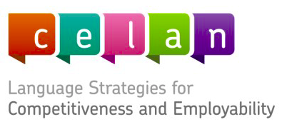
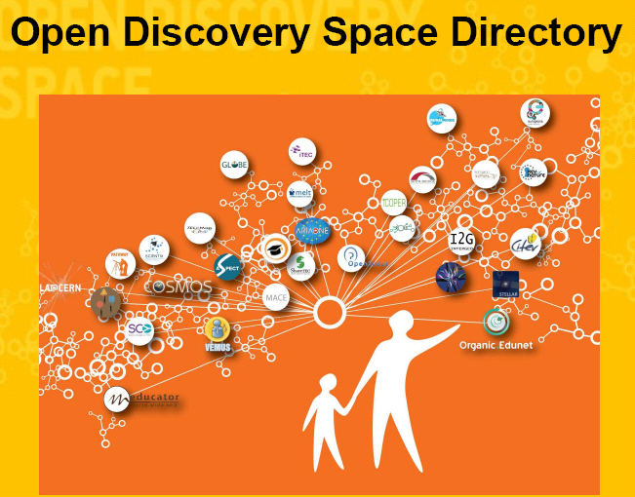





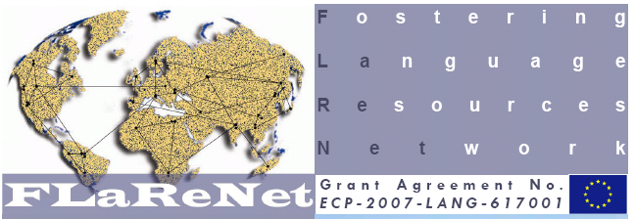





A selection of projects, initiatives, organisational settings

Slide 18
Exploiting Diversity & Convergences
Among and across
  Academic research disciplines
  Industry sectors
  Public sectors
  Language communities
  World regions (geo-political, socio-economic dimensions)
  Cultures
    Organisational cultures
    Professional cultures/domains
    Social cultures
    National/ethnic/linguistic cultures
-> Cross-cultural management is helpful in order organise settings enabling us to exploit this diversity as well as to identify, enable, foster, and implement convergences

Slide 19
What are language resources?
(digital) collections of language data, language corpora
  Full texts (in all languages, in diverse text types/genres)
  Digital lexical resources (MDRs, etc.), terminologies, ontologies
  Lexicographical and terminographical resources (e.g. for dictionary production)
  All modalities and presentation forms (spoken/speech, written, multi-modal, etc.)
  Most diverse forms of use and different purposes
  In all languages, in all domains, in all application contexts where they occur (…but needed for research)
…what is the difference between language resources and corpora? The former concept is broader than the latter

Slide 20
What are language technologies?
Technologies for
  Language analysis, corpus analysis, language processing, text technologies
  Speech recognition, speech production, text production (multi-modal)
  Machine translation, computer-assisted translation (multi-modal)
  Dictionary production
  Technical documentation, technical communication
  And many more

Slide 21
Goals
unite existing digital archives into a federation of connected archives with unified web access
provide language and speech technology tools as web services operating on (language) data in archives -> SOA architecture using SW standards
-> implementation of relevant interoperability standards
Provide access to data for scholars, support them in their work (on collaborative platforms) and encourage them to provide their data and tools to research colleagues free of charge (if possible)
Overcome high degree of fragmentation (due to lack of coordination, visibility, interoperability and of sustainability)
Provide expertise in all countries (service network)
Provide language independent tools that can be shared

Slide 22
User scenarios – survey and needs analysis
Corpus analysis (socio-linguistic/text linguistic perspectives on language use, etc.)
preparing terminological and lexicographical resources
Mono- and multilingual identification and extraction of terminology and phraseology from full text corpora
Analysis of speech, multimodal resources (speeches, discourse data, videos, film, etc.): essential for empirical research in interpreting, in cross-cultural communication and translation studies
Automatic corpus generation
eLearning support – corpus-based language learning
Dialectology support
Historical semantics, historical lexicology
Automated metadata generation for corpora
Multiword extraction
Annotation support
Collaborative work-flows!

Slide 23
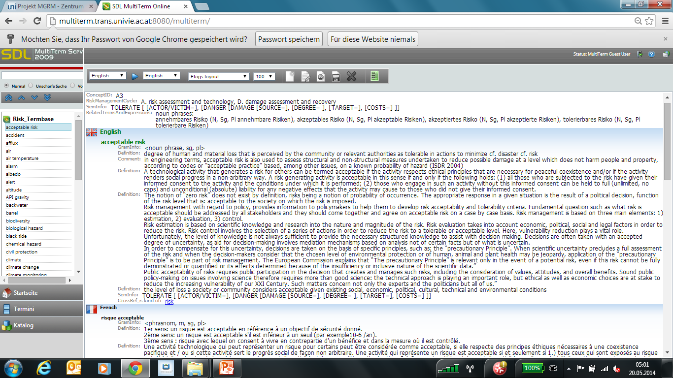

Slide 24
From texts and terminologies to ontologies
Using the Risk scenario
  Termbase
    Export XML
    Domain Models – meta-models -> patterns
  Text corpus
    Term extraction – comparative testing ProTerm, MultiTerm Extract, MultiCorpora
    Aligning with termbase
    Convert to RDF
  Ontology import -> editor
  Mappings (GMT, XML, RDF, OWL, UML, comma delimited, RDB, for different kinds of lex-term resources, FN->OWL, etc.)
The MULTH-WIN Project as an example of methods integration:

Slide 25
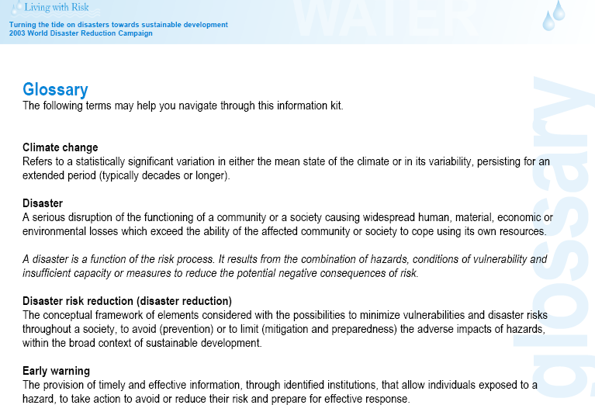

Slide 26
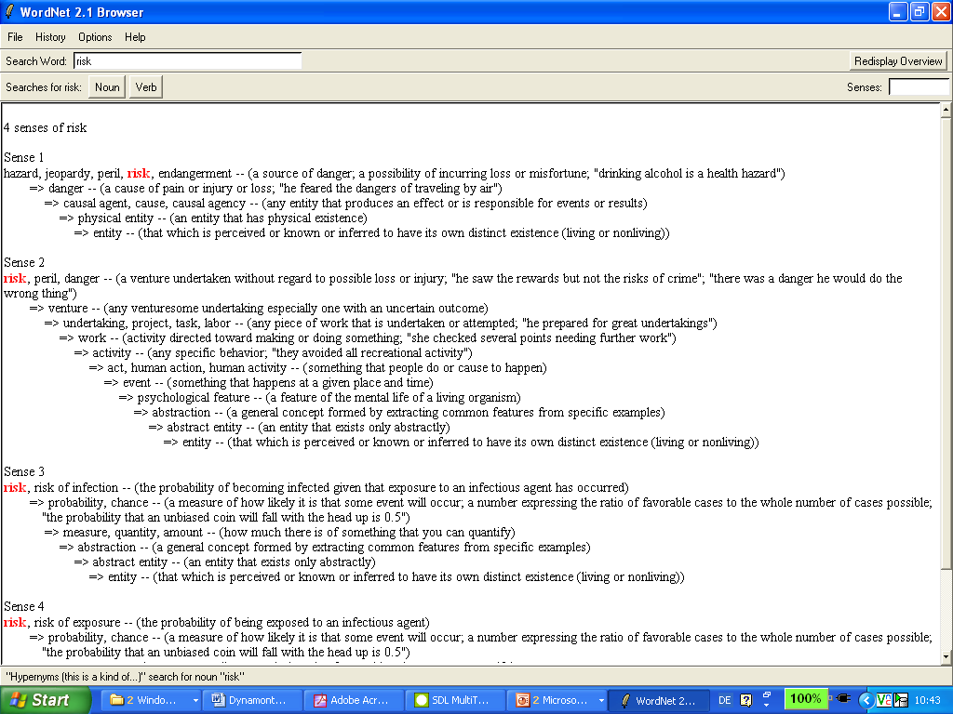

Slide 27
Terminological frame semantics
INTERVENTION (ACTOR(S), ACTIVITIES/PHASES):
RISK DETECTING (PRE-EVENT)
- R-ASSESSMENT
- R-PERCEPTION (X is risk)
- EXPERIENCE (statistics, case studies)
- OBSERVATION (monitoring)
- METHOD
- SATELLITE
- PROGNOSES
- R-ANALYSIS
- R-FEATURES
- SITUATION/CONTEXT (danger/hazard)
- SIMULATION (course of events)
- PROBALISTIC METHODS (safety)
- RELIABILITY
- R-IDENTIFICATION (DAMAGE)
- R-SOURCE
- DAMAGE CAUSE
- VULNERABILITY (DAMAGE TARGET)
- SUSCEPTABILITY (capacity/people)
Rothkegel

Slide 28
Terminological frame semantics
I. Pre-event B. Public awareness and planning, II. In-event: C. Events and response
afflux/Hochwasser durch Aufstau
BE [[TYPE=flood], [PLACE=], [TIME=]],
HAVE [CAUSE [[ORIGIN=], [NIEDERSCHLAG [TYPE=]], [STAU [TYPE= Aufstau]]],
DAMAGE [TARGET=, SOURCE=, DEGREE=]],
HAPPEN [STATES=, PROCESSES=]]
backwater/Rückstau
BE [[TYPE=flood], [PLACE=], [TIME=]],
HAVE [CAUSE [[ORIGIN=], [NIEDERSCHLAG [TYPE=]], [STAU [TYPE= Rückstau]]],
DAMAGE [TARGET=, SOURCE=, DEGREE=]],
HAPPEN [STATES=, PROCESSES=]]
Rothkegel

Slide 29
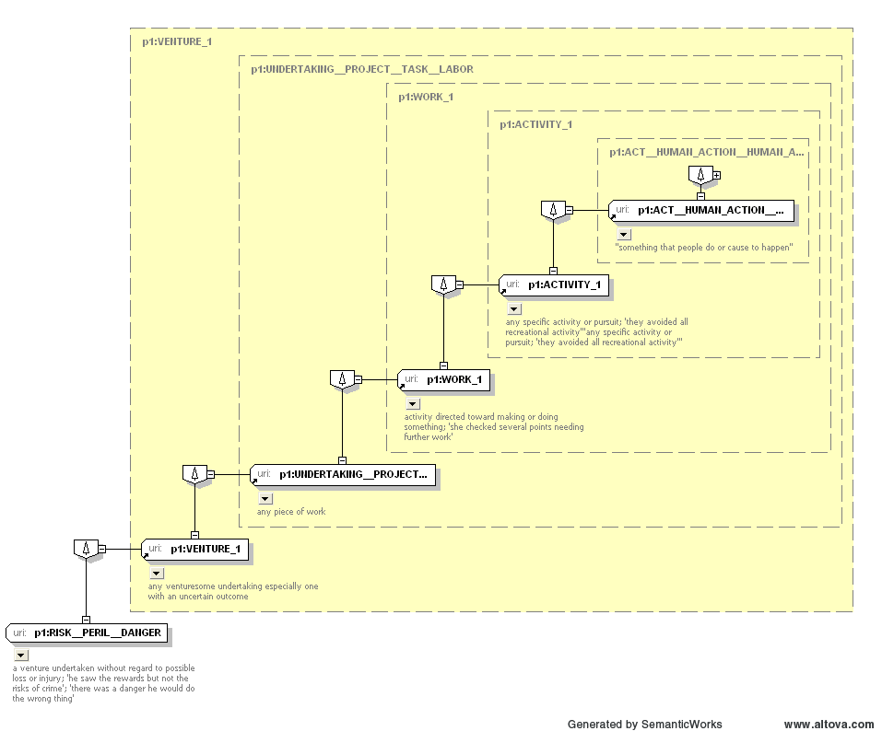

Slide 30
Ordnance Survey

Slide 31
Ordnance Survey

Slide 32
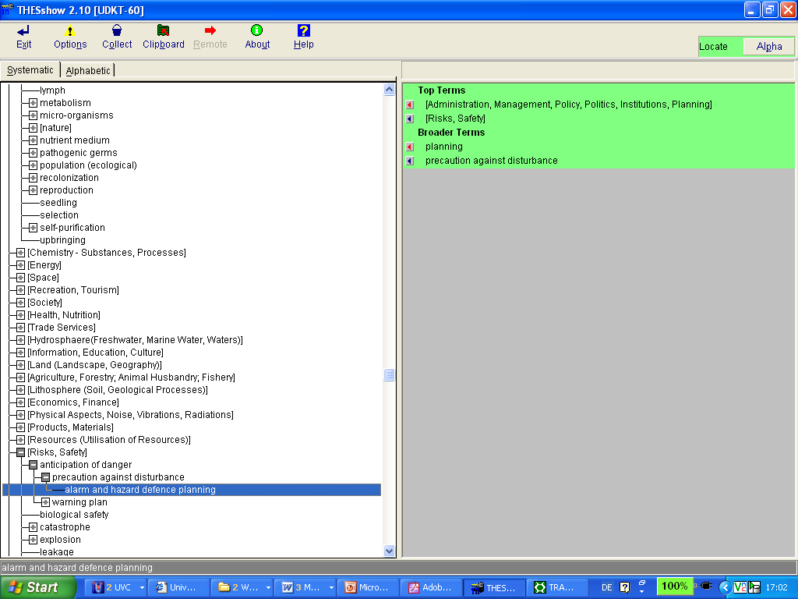

Slide 33
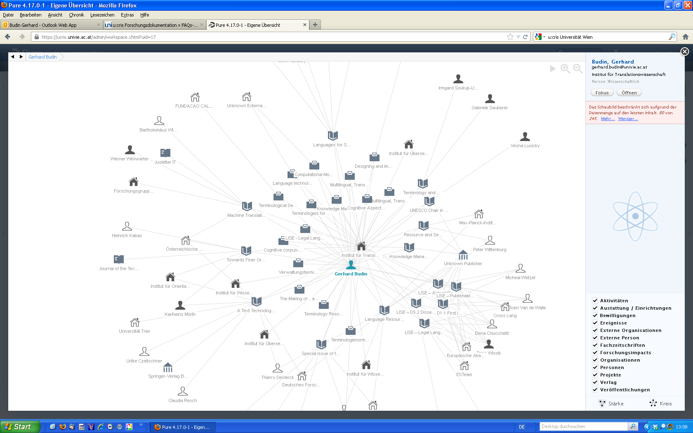

Slide 34

DARIAH: The Digital Research Infrastructure for the Arts and Humanities
  Support for computer-based („digitally enabled“) humanities research
  Development of a RI for computational research methods and processes for analysing empirical data
Like CLARIN, it started in 2007 with a preparatory phase and is now entering the construction phase (20 year life-cycle) with DARIAH ERIC being founded
http://www.dariah.eu/

Slide 35
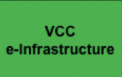

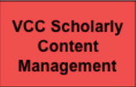

DARIAH work: VCCs – virtual competence centres
Conference series: „Supporting the Digital Humanities“
Regular workshops and meetings
4 „Virtual Competence Centres“

Slide 36

DASISH creates synergies between the 5 ESFRI-Initiatives in SSH – social sciences and humanities (CLARIN/ DARIAH/ESS/ CESSDA/SHARE)
19 Partner institutions from 12 countries (ICLTT/AAS represents Austria), of the 5 initiatives
Goals
  Joint Meta data architecture
  Collaborative work on data quality, PIDs, legal and ethical aspects, data access/open data
  workshops
  Interdisziplinary user scenarios
http://www.dasish.eu
DASISH is a FP7-INFRASTRUCTURES-2011-1 project; Grant Agreement 283646, Combination of CP & CSA. The project duration is 36 months, starting on 1st January 2012 and ending on 31st December 2014

Slide 37
Benefits - Computational Science in the Humanities
CLARIN/DARIAH are contributions to Initiatives in eScience or computational science in general and to Digital Humanities (DH) in particular by building up research infrastructures
  Enlarging and improving the empirical data basis (depth and breadth)
  Enabling empirical testing of hypotheses in humanities research based on large data sets and their processing
  Enabling new research paradigms e.g. for using multimodal and multimedia corpora and language technologies
  Only possible in a collaborative, distributed manner with standardized workflows, common annotation semantics, common metadata schemes
See Science Policy Briefing 42 (2011) „Research Infrastructures in the Digital Humanities“ of the European Science Foundation

Slide 38
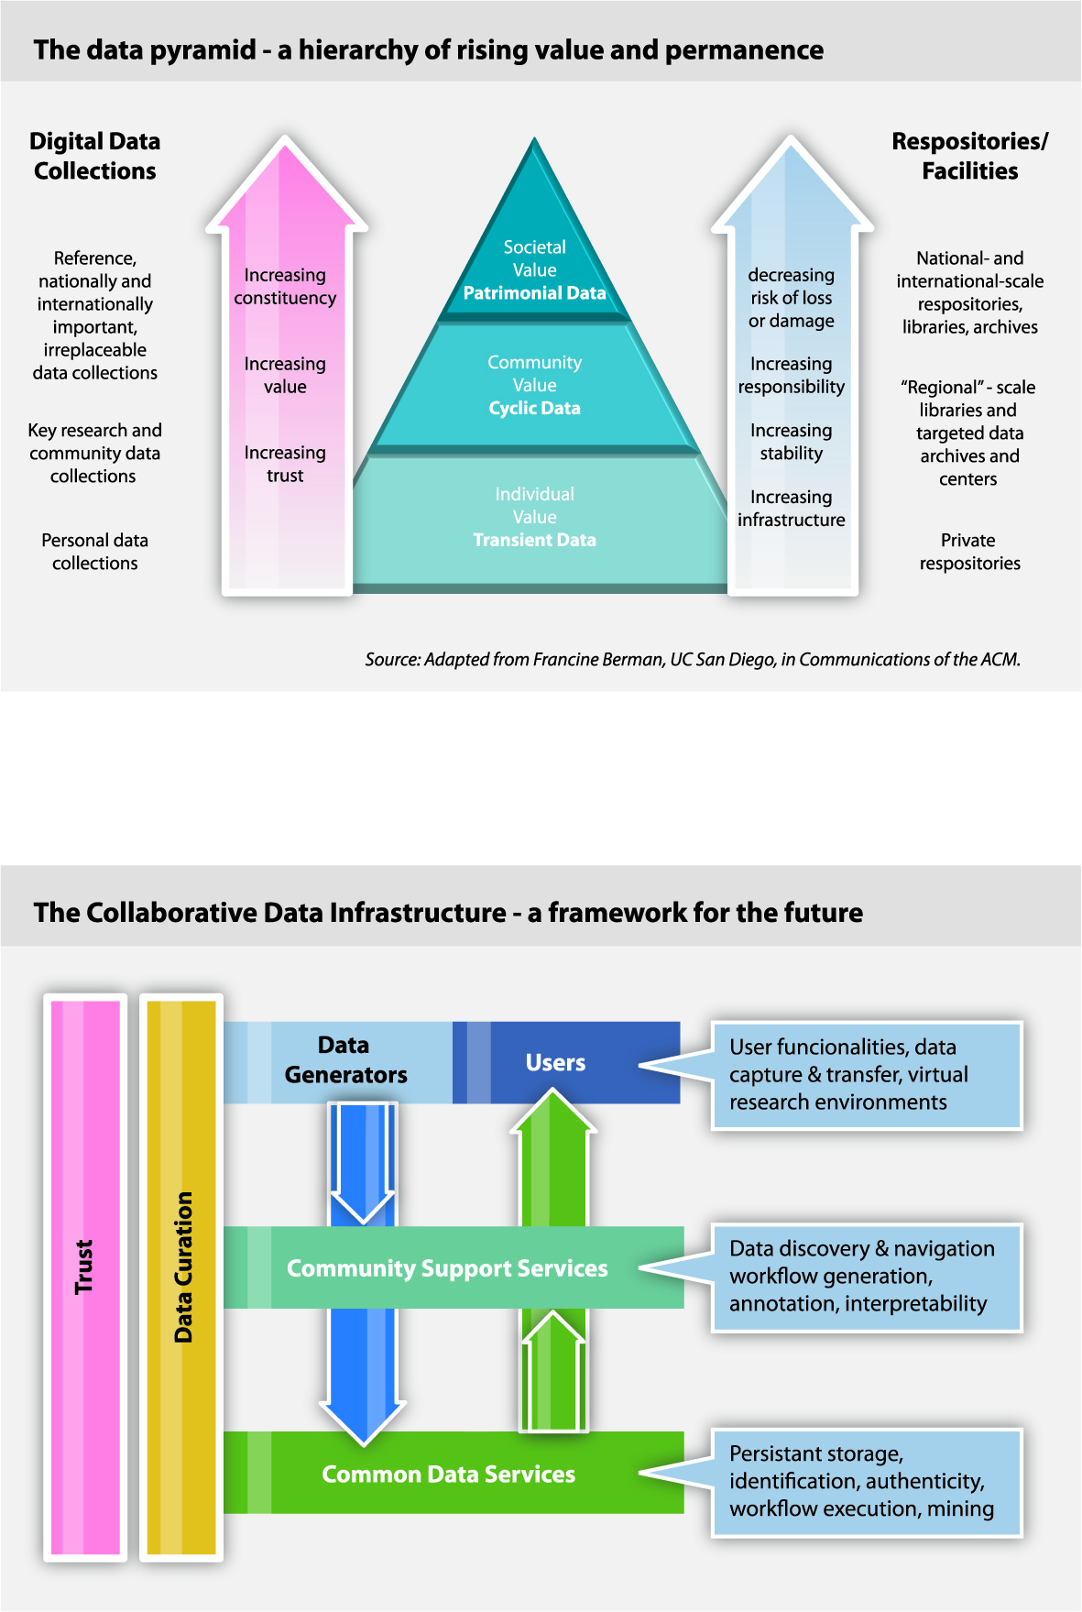
Virtual Research Environments
-> Virtual Research Environments (VRE)
  include
    Tools (sw, web services, etc.)
    Data
    Expertise, Training, tutorials
  Personalisation of VREs
  Intra-, Inter- u. Trans disciplinarity
  „Collaboratories“
    CDI: Collaborative Data Infrastructures
    Collaborative research
    Creating and curating data sets
    data objects must be part of career plans
    -> data scientists

Slide 39
Outlook: a lot remains to be done
Cross-sectoral co-operation (within the EU, etc.)
SWOT analysis + innovation value chains + critical technology assessment for all activities
„Big Data“ goes multilingual -> Translingual Cloud (Meta-Net), Open Linked Data, H2020 – Connecting Europe Facility, focus on quality machine translation, etc.
-> Innovating and re-defining our curricula (incl. new partnerships, and re-defining internal relations (students/teachers/researchers)
eScience + eLearning + eWork (interactive bootstrapping, incl. Long-term preservation, data enrichment, etc.)

Slide 40
PHAIDRA, U:CRIS
MOODLE, Big Data DigHum Labs
CLARIN-AT/-EU
DARIAH-AT/-EU
Other Ris…
Research projects intra- and interdisciplinary
eLearning

